Slide 1
Pac-MAN GAME
Presented by
Sarayu Tokala 1NH21IS138
Aastha Bhardwaj 1NH21IS001
P Tejaswini Reddy 1NH21IS106
Rudrakshi Lamba 1NH21CS201

Slide 2
History of pac-man:
PAC-MAN was known as puck man in Japan and is the main protagonist of Pac-Man series. Pac man had two children named baby Pac-man, Jr pac-man and spouse named Ms Pac-man. He was created by Toru –Iwatani. This character appearance was in 1980and Pac-man become legendary video game icon and one among the most recognized character in the world. In this game his meal include Pac-Dots

Slide 3
Objective of Pac Man
The objective is to develop software program ofPac-Man game by python programming languages as it reduces the progrram length. This is programs to be used in small application.
This game is created in 2D model. We have not given options for players to play like 2 or more players

Slide 4
Modules used
pygame
Player
Enemies
ktintr

Slide 5
Pac-MAN GAME
Presented by
Sarayu 1NH21IS138
Aastha Bhardwaj 1NH21IS001
Rudrakshi Lamba 1NH21CS201
P Tejaswini Reddy 1NH21IS106

Slide 6
Functions used
_init_(self)
process_events(self)
run_logic(self)
display_frame(self,screen)
display_message(self,screen,message,color=(255,0,0))
event_handler(self,event)

Slide 7
Program
import pygame
from player import Player
from enemies import *
import tkinter
from tkinter import messagebox
SCREEN_WIDTH = 800
SCREEN_HEIGHT = 576
BLACK = (0,0,0)
WHITE = (255,255,255)
BLUE = (0,0,255)
RED = (255,0,0)

Slide 8
class Game(object):
def _init_(self):
self.font = pygame.font.Font(None,40)
self.about = False
self.game_over = True
self.score = 0
self.font = pygame.font.Font(None,35)
self.menu = Menu(("Start","About","Exit"),font_color = WHITE,font_size=60)
self.player = Player(32,128,"player.png")
self.horizontal_blocks = pygame.sprite.Group()
self.vertical_blocks = pygame.sprite.Group()
self.dots_group = pygame.sprite.Group()

Slide 9
for i,row in enumerate(enviroment()):
for j,item in enumerate(row):
if item == 1:
self.horizontal_blocks.add(Block(j*32+8,i*32+8,BLACK,16,16))
elif item == 2:
self.vertical_blocks.add(Block(j*32+8,i*32+8,BLACK,16,16))
self.enemies = pygame.sprite.Group()
self.enemies.add(Slime(288,96,0,2))
self.enemies.add(Slime(288,320,0,-2))
self.enemies.add(Slime(544,128,0,2))
self.enemies.add(Slime(32,224,0,2))
self.enemies.add(Slime(160,64,2,0))
self.enemies.add(Slime(448,64,-2,0))
self.enemies.add(Slime(640,448,2,0))
self.enemies.add(Slime(448,320,2,0))

Slide 10
for i, row in enumerate(enviroment()):
for j, item in enumerate(row):
if item != 0:
self.dots_group.add(Ellipse(j*32+12,i*32+12,WHITE,8,8))
self.pacman_sound = pygame.mixer.Sound("pacman_sound.ogg")
self.game_over_sound = pygame.mixer.Sound("game_over_sound.ogg")

Slide 11
def process_events(self):
for event in pygame.event.get(): # User did something
if event.type == pygame.QUIT: # If user clicked close
return True
self.menu.event_handler(event)
if event.type == pygame.KEYDOWN:
if event.key == pygame.K_RETURN:
if self.game_over and not self.about:
if self.menu.state == 0:
self._init_()
self.game_over = False
elif self.menu.state == 1:
self.about = True
elif self.menu.state == 2:
return True
elif event.key == pygame.K_RIGHT:
self.player.move_right()
elif event.key == pygame.K_LEFT:
self.player.move_left()
elif event.key == pygame.K_UP:
self.player.move_up()

Slide 12
elif event.key == pygame.K DOWN:
self.player.move_down()
elif event.key == pygame.K_ESCAPE:
self.game_over = True
self.about = False
elif event.type == pygame.KEYUP:
if event.key == pygame.K_RIGHT:
self.player.stop_move_right()
elif event.key == pygame.K_LEFT:
self.player.stop_move_left()
elif event.key == pygame.K_UP:
self.player.stop_move_up()
elif event.key == pygame.K_DOWN:
self.player.stop_move_down()
elif event.type == pygame.MOUSEBUTTONDOWN:
self.player.explosion = True
return False

Slide 13
self.player.explosion = True
self.game_over_sound.play()
self.game_over = self.player.game_over
self.enemies.update(self.horizontal_blocks,self.vertical_blocks)
def display_frame(self,screen):
screen.fill(BLACK)
if self.game_over:
if self.about: def run_logic(self):
if not self.game_over:
self.player.update(self.horizontal_blocks,self.vertical_blocks)
block_hit_list = pygame.sprite.spritecollide(self.player,self.dots_group,True)
if len(block_hit_list):
self.pacman_sound.play()
self.score += 1
block_hit_list = pygame.sprite.spritecollide(self.player,self.enemies,True)
if len(block_hit_list):
self.display_message(screen,"It is an arcade Game")
else:
self.menu.display_frame(screen)

Slide 14
else:
self.menu.display_frame(screen)
height = label.get_height()
posX = (SCREEN_WIDTH /2) - (width /2)
posY = (SCREEN_HEIGHT /2) - (height /2)
screen.blit(label,(posX,posY))
class Menu(object):
state = 0
def _init_(self,items,font_color=(0,0,0),select_color=(255,0,0),ttf_font=None,font_size=25):
self.font_color = font_color
self.select_color = select_color
self.items = items
self.font = pygame.font.Font(ttf_font,font_size)

Slide 15
class Menu(object):
state = 0
def _init_(self,items,font_color=(0,0,0),select_color=(255,0,0),ttf_font=None,font_size=25):
self.font_color = font_color
self.select_color = select_color
self.items = items
self.font = pygame.font.Font(ttf_font,font_size)
def display_frame(self,screen):
for index, item in enumerate(self.items):
if self.state == index:
label = self.font.render(item,True,self.select_color)
else:
label = self.font.render(item,True,self.font_color)
width = label.get_width()
height = label.get_height()
posX = (SCREEN_WIDTH /2) - (width /2)
t_h = len(self.items) * height
posY = (SCREEN_HEIGHT /2) - (t_h /2) + (index * height)
screen.blit(label,(posX,posY))

Slide 16
def event_handler(self,event):
if event.type == pygame.KEYDOWN:
if event.key == pygame.K_UP:
if self.state:
self.state -= 1
elif event.key == pygame.K_DOWN:
if self.state &lt: len(self.items) -1
self.state += 1

Slide 17
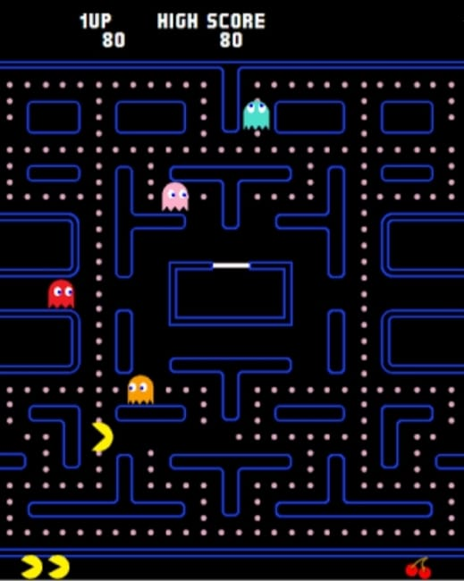
Pac-Man Program Output

Slide 18
THANK YOU

